Slide 1
INDIA
The Land of Festivals

Slide 2
There are many different types of festivals that Indians celebrate . Which mainly include:-
DIWALI
HOLI
JANMASHTAMI

Slide 3
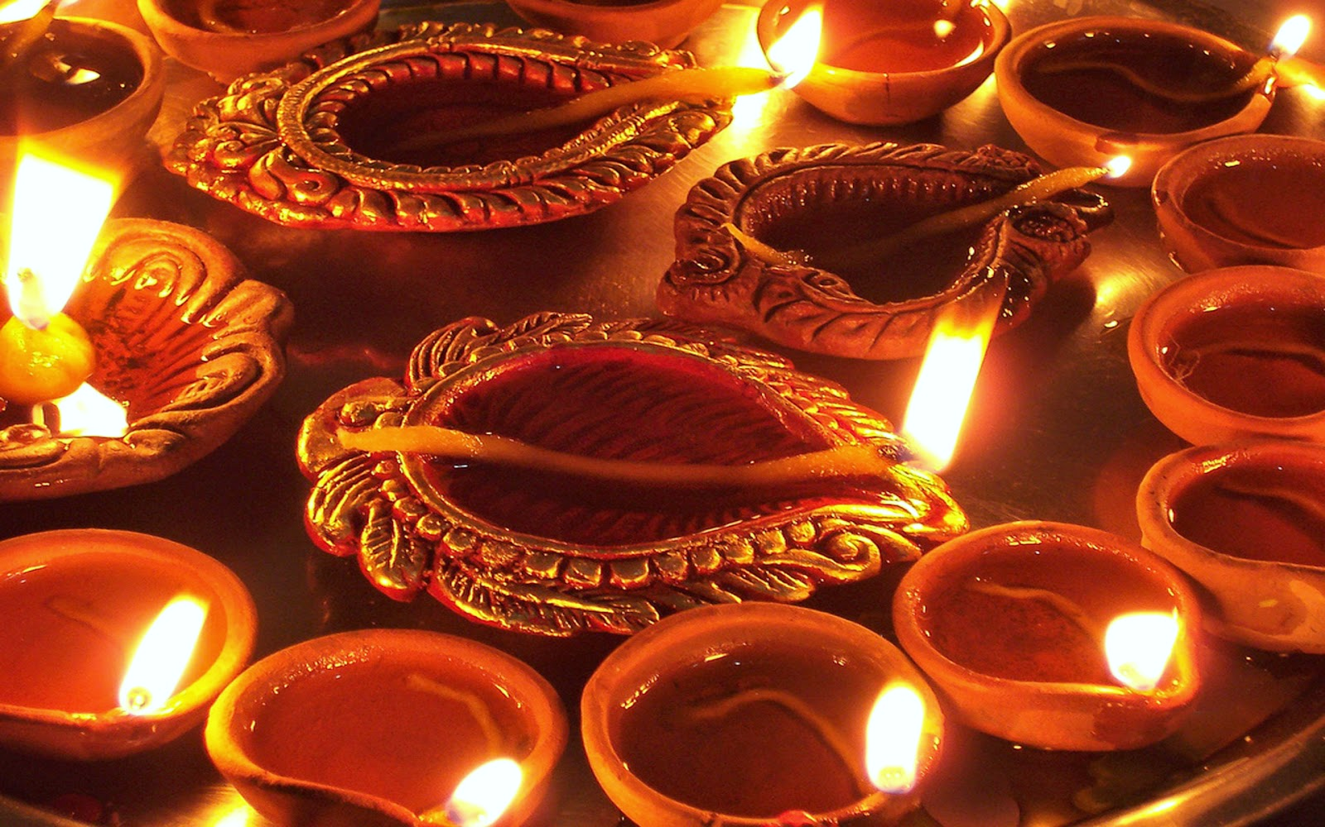
Diwali (Deepavali)
Celebrated by: Hindus, Sikhs, Jains, and Buddhists
Significance: Diwali, the Festival of Lights, celebrates the victory of light over darkness and good over evil. It marks the return of Lord Rama to his kingdom after defeating the demon king Ravana. Homes are decorated with oil lamps (diyas), rangoli, and fireworks.

Slide 4
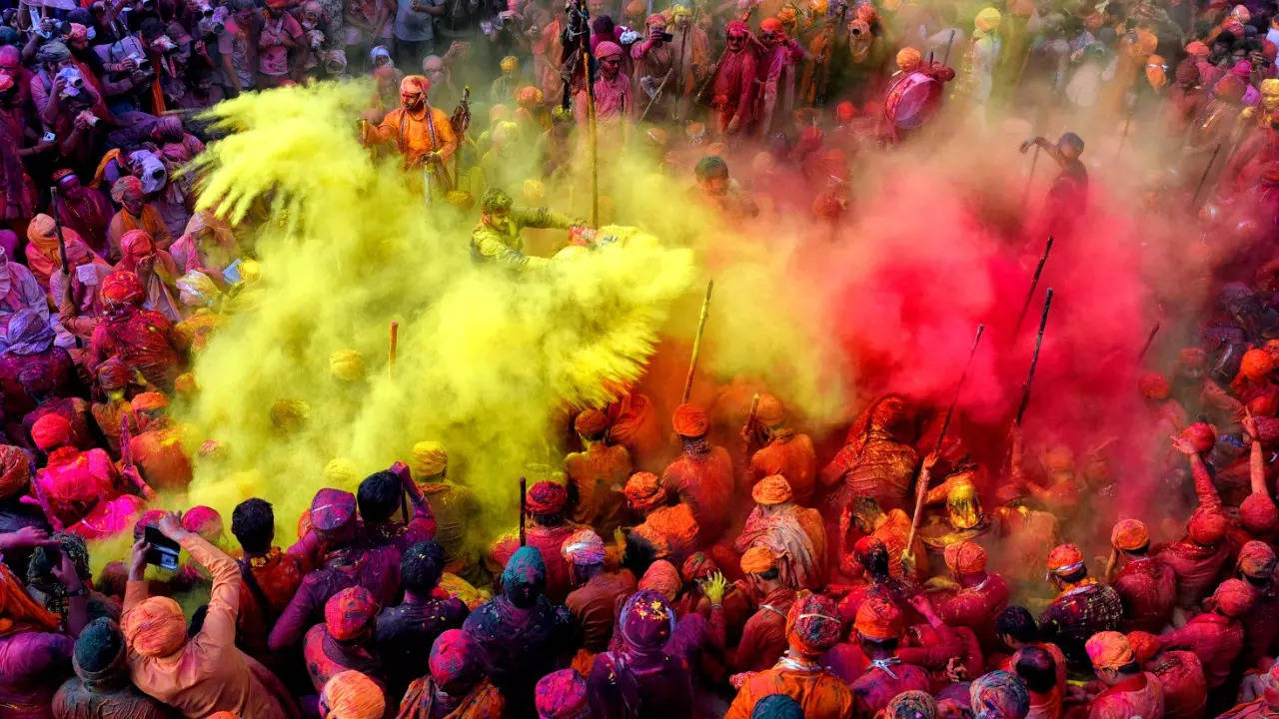
Holi
Celebrated by: Hindus.
Significance: Holi signifies the arrival of spring and the triumph of good over evil. It celebrates the love of Lord Krishna for Radha and the victory of Prahlad over his evil father, Hiranyakashipu.

Slide 5
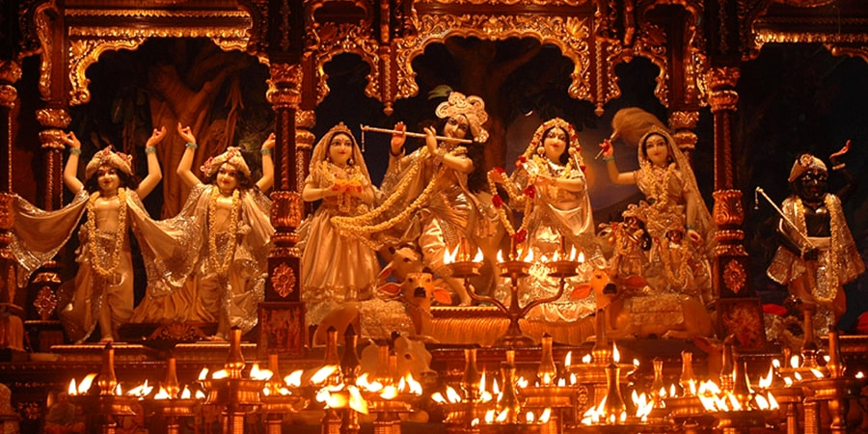
Janmashtami
Celebrated by: Hindus.
Significance: Janmashtami celebrates the birth of Lord Krishna, an incarnation of Lord Vishnu, who is believed to have come to earth to defeat evil forces and restore righteousness.

